Slide 1

Operating Systems
Designed by Mr. M Mudassar

Slide 2
Outline
Process
Threads
CPU Scheduling
Process Synchronization
Deadlocks
Memory Management
Virtual Memory
File System
I/O System
Disk Management
Protection
Security

Slide 3
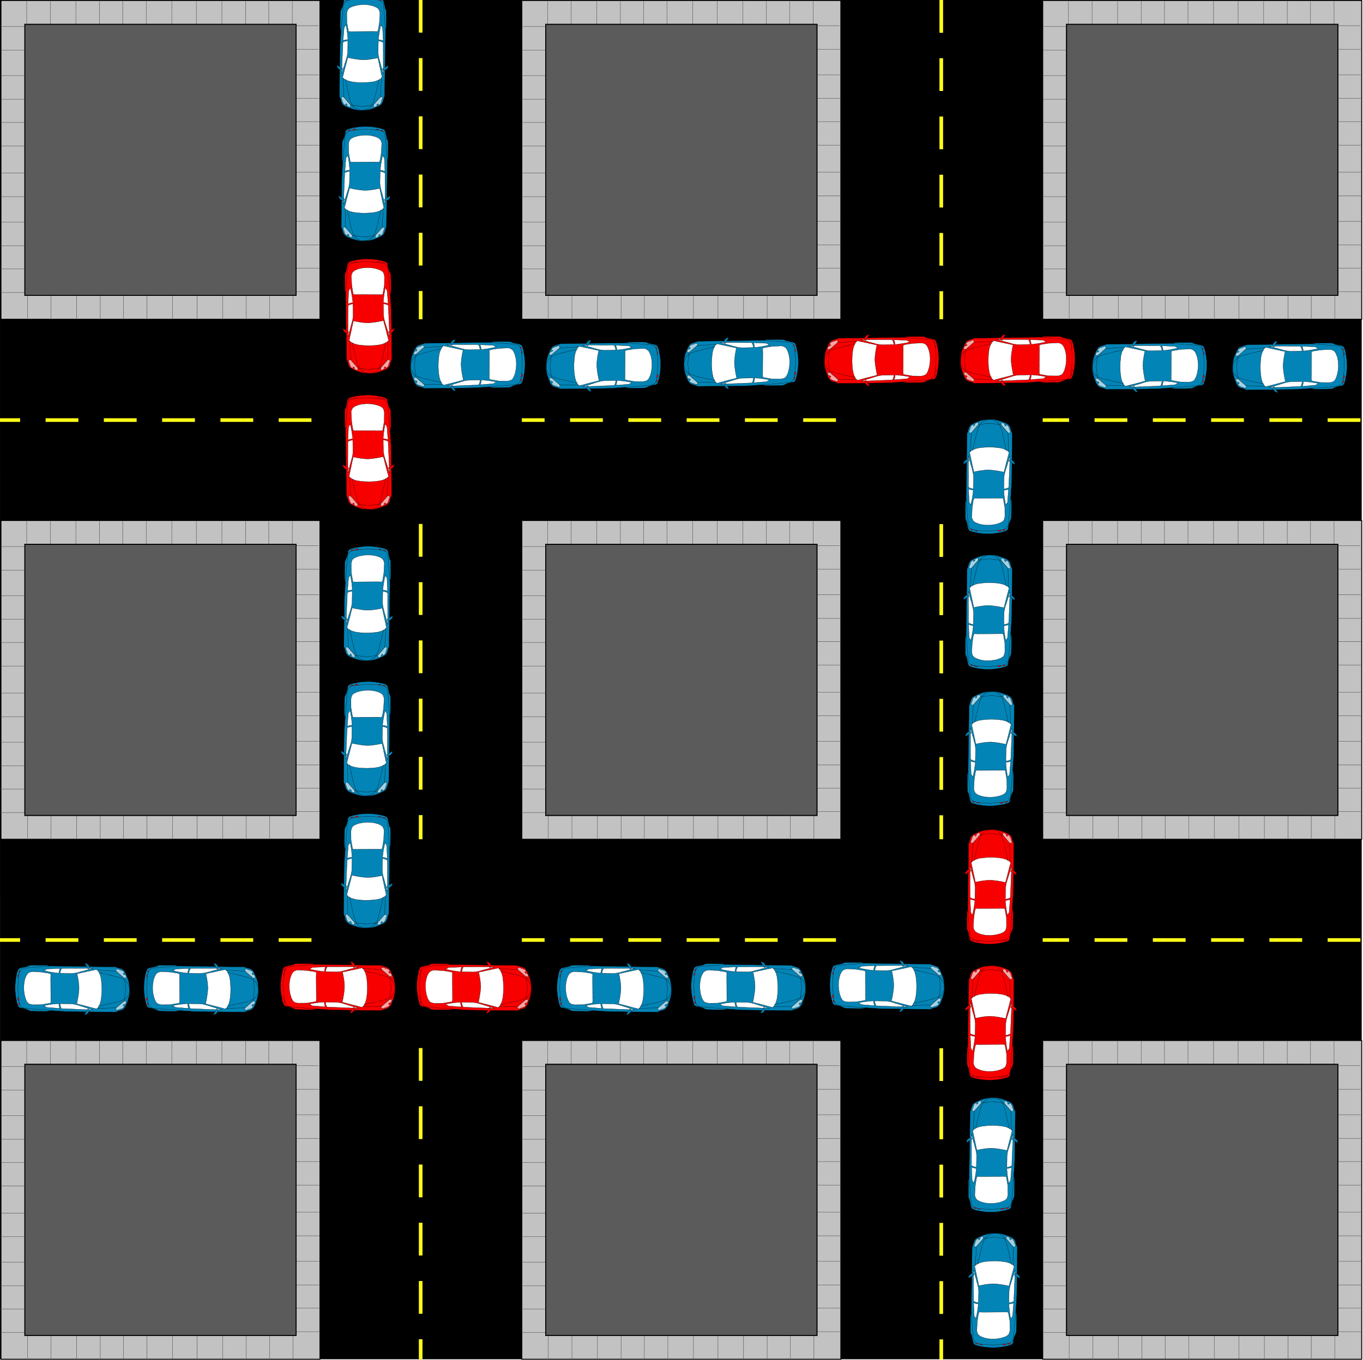
Deadlocks
Introduction
A process or thread in the state deadlock if it is waiting for a particular event that will not occur.
Resource allocation sequence
Request
Use
Release
Deadlock characterization
Mutual Exclusion
Hold and Wait (R1,R2,R3, P)
No Preemption (when release?)
Circular Wait (P0,P2,…,Pn-1)
Exams
Shared or non-sharable (Printer, read-only file)
Tap Drive
Printer
Read only File

Slide 4
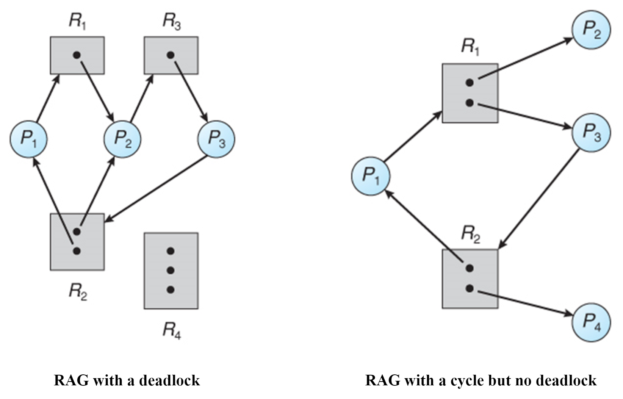
Resource Allocation Graph (RAG)
RAG requires:
Process
Resource
Instance
Age
Request age
Allocation age

Slide 5
Deadlock Prevention, and Coffman necessary conditions
Deadlock
Deadlock Prevention
Deadlock Avoidance
Deadlock Detection
Deadlock Recovery
Coffman necessary conditions
Mutual Exclusion
Sharable or non-sharable?
Hold and Wait
Completion of processes
Starvation
No Preemption
Circular Wait
Priority
Pharmacy example
Function(tape-drive=1)
Function(disk-drive=3)
Function(printer=7)

Slide 6
Deadlock Avoidance, Banker’s Algorithm with example
Safe state vs Unsafe state
Work and Finish be two vectors of size m (no. of resources) and n (no. of processes). Initialize work with available and Finish[i]=False for i=1 to n.
Find an i such that both
Finish[i] = False
Need_{i} ≤ Work
If no such i exists, then goto step 4
Work = Work + Allocation_{i}
Finish[i]=True
Gogo step 2
If Finish[i] = True for all i, then the system is in safe state.
Unsafe State
Deadlock
Safe State

Slide 7
Deadlock Avoidance, Banker’s Algorithm with example
 | Allocation |  |  |  | Max |  |  |  | Available
 | A | B | C | D | A | B | C | D | A | B | C | D
P0 | 0 | 0 | 1 | 2 | 0 | 0 | 1 | 2 | 1 | 5 | 2 | 0
P1 | 1 | 0 | 0 | 0 | 1 | 7 | 5 | 0
P2 | 1 | 3 | 5 | 4 | 2 | 3 | 5 | 6
P3 | 0 | 6 | 3 | 2 | 0 | 6 | 5 | 2
P4 | 0 | 0 | 1 | 4 | 0 | 6 | 5 | 6
n = no. of processes = 5
P0 to P4
m = no. of resources = 4
A, B, C, D
Available[m]
Allocation[n x m]
Max[n x m]
Need[n x m]
(Max – Allocation)
Calculate matrix Need.
Is the system being in a safe state?
If P_{i} arrives with request (0,3,2,0), can it be granted immediately?

Slide 8
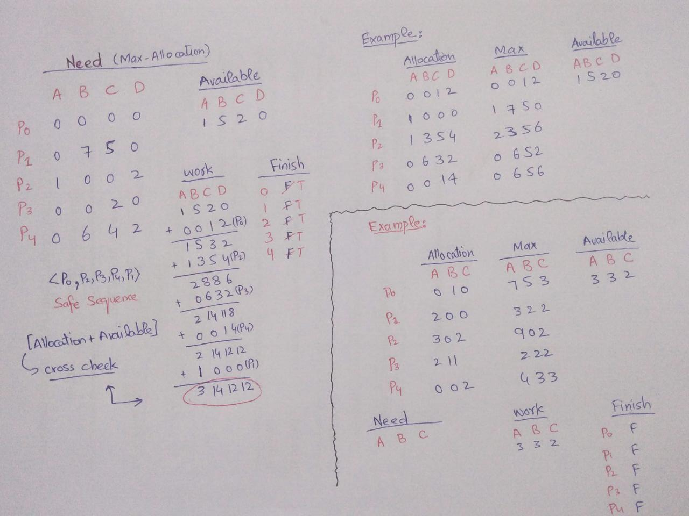
Deadlock Avoidance, Banker’s Algorithm with example

Slide 9
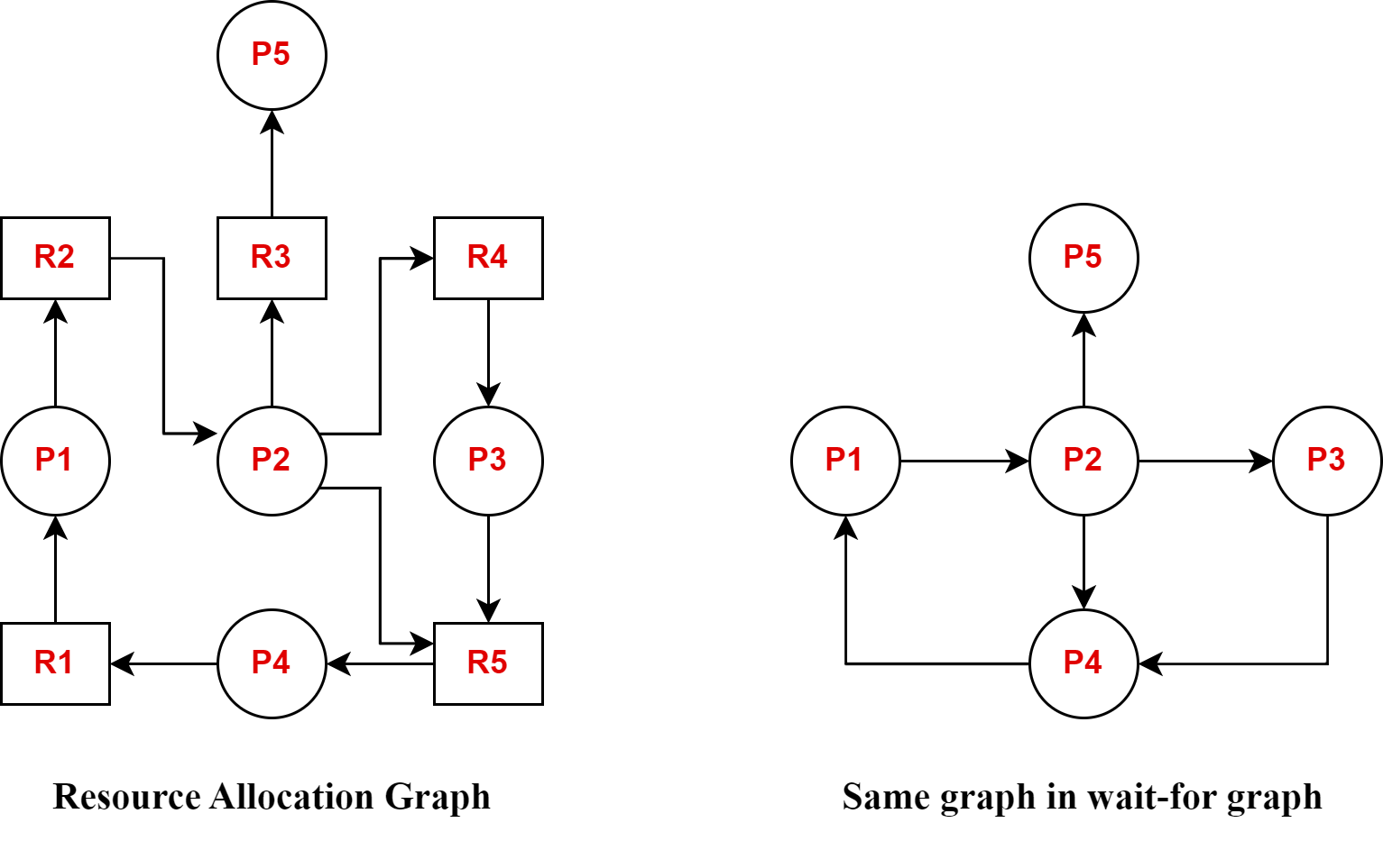
Deadlock Detection
If there is a cycle in wait-for graph with a not, then deadlock is bound to be occur.

Slide 10
Deadlock Recovery
Process termination
Abort all deadlock processes
Abort one process at a time until deadlock cycle is eliminated
Resource Preemption
Selecting a victim (min cost)
Rollback
Starvation

Slide 11

References
https://youtu.be/ZfFa_aWV9nE
https://youtu.be/sgnmuL-0hic
https://youtu.be/1dbZxRkbZCY
https://youtu.be/FdQ4EhMvhPE
https://youtu.be/ZTp8QAyl-Ls

Slide 12
Thank You(Q & A)

